Slide 1
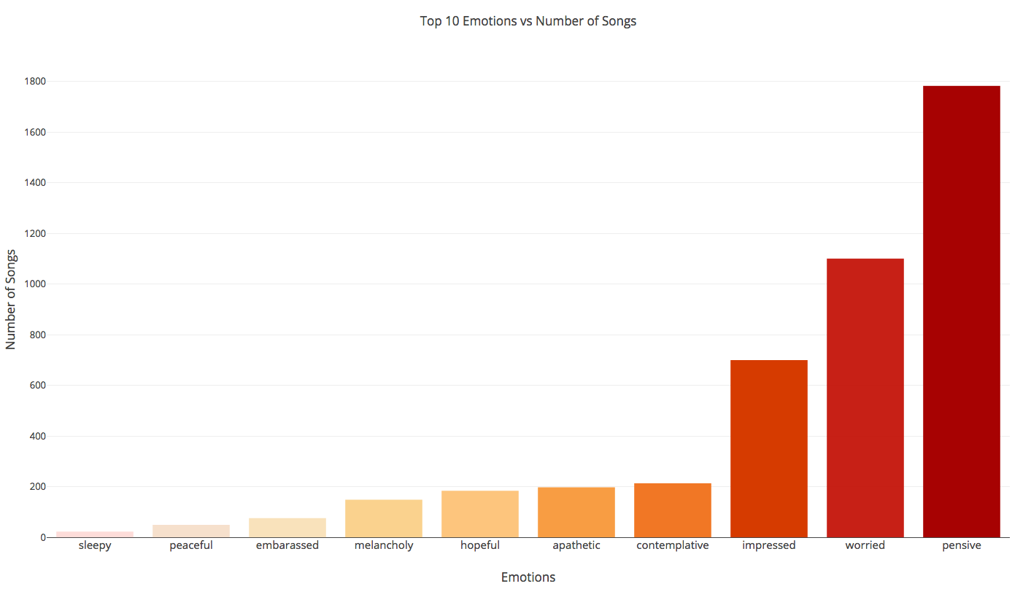
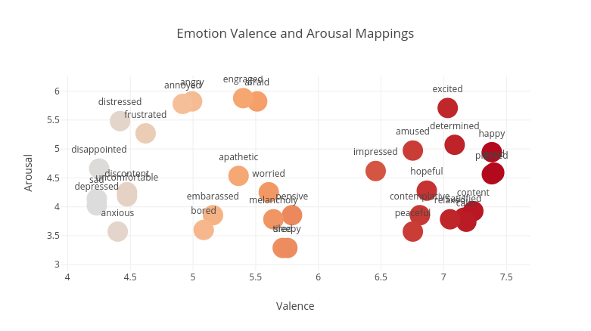
Emotion Classification of Song Lyrics
Dani Mednikoff & Jen Zhu
CS 585: Natural Language Processing, Fall 2017
Introduction
Our goal was to accurately classify songs according to the emotions expressed through the lyrics
We used a system of valence and arousal:
Tools & Data
Song Lyrics:
Kaggle Billboard Top 100 from 1964 – 2015 dataset, removing instrumental and non-English songs
5,057 songs
Includes song title, rank, year, artist and lyrics
Word Dictionary:
14,000 words
Valence and arousal scores
Emotion Dictionary:
34 Emotions
Valence and arousal scores
Approach
Created a bag of words for each song from data set
Calculated average valence and arousal values for the song:
Locate word’s valence and arousal scores, multiplied by the number of times word was repeated
Divided avg by # of words located
Scaled each emotion’s valence and arousal range
Used Euclidean distance to map the nearest emotion to a song’s average valence and arousal scores
Results
Top 10 Emotions and Number of Songs: sleepy (23), peaceful (50), embarrassed (76), melancholy (149), hopeful (184), apathetic (198), contemplative (214), impressed (700), worried (1101), pensive (1783)
Examples: “Happy”: amused, “Halo”: peaceful, “Teardrops on My Guitar”: contemplative
Future Implementations
Address words not located via synonym lexicons
Using additional information such as artist, year, rank to discover patterns
References: (1) Yajie H., Xiaoou C., & Deshun Y. (2009), “Lyric-Based Song Emotion Detection With Affective Lexicon and Fuzzy Clustering Method,” 10th International Society for Information Music Retrieval Conference, 123-128 (2) Chinatsu A., Mary Ellen O., James G., Bjornar L. “A Scalable Summarization System Using Robust NLP”, 66-73 (3) Yang, Dan, and Won-Sook Lee. “Music Emotion Identification from Lyrics.” 2009 11th IEEE International Symposium on Multimedia, 2009, doi:10.1109/ism.2009.123. (4) Kim, Youngmoo E., et al. “MUSIC EMOTION RECOGNITION: A STATE OF THE ART REVIEW.” International Society for Music Information Retrieval Conference, vol. 11, 2010, pp. 255–260. ISMIR, www.ismir2010.ismir.net/proceedings/ismir2010-45.pdf.

